Slide 1
Financial Management
Lecture 9: Risk and Return

Slide 2
Part 1: Realised and Expected Rates of Return and Risk

Slide 3
Risk and return
Why do people invest? To make return.
The return investors require for a particular investment depends on the risk associated with the investment
Higher risk means there is less certainty about the return the investor might get.
Investors do not like this uncertainty and therefore want to be compensated for bearing risk
The greater the risk, the larger the return investors require as compensation for bearing that risk
Today we will look at a number of ways of measuring return and risk, depending on the context

Slide 4
Calculating the realised return from an investment
Cash return measures the gain or loss on an investment.
Example: You invested in 1 share of Apple (AAPL) for $95 and sold a year later for $200. The company did not pay any dividend during that period. What will be the cash return on this investment?

Slide 5
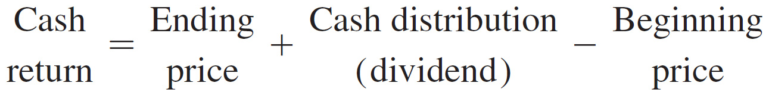
Calculating the realised return from an investment (cont.)
Cash return = $200 + 0 − $95
= $105

Slide 6
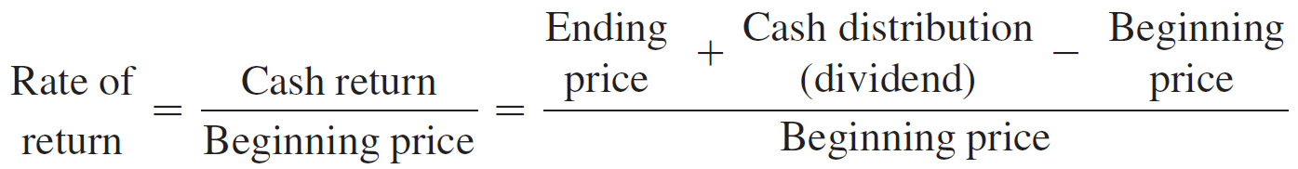
Calculating the realised return from an investment (cont.)
We can also calculate the rate of return as a percentage. It is simply the cash return divided by the beginning stock price.

Slide 7
Calculating the realised return from an investment (cont.)
Example: Calculate the rate of return for the previous example.
Rate of return = ($200 + 0 − $95) ÷ 95
= 110.53%

Slide 8
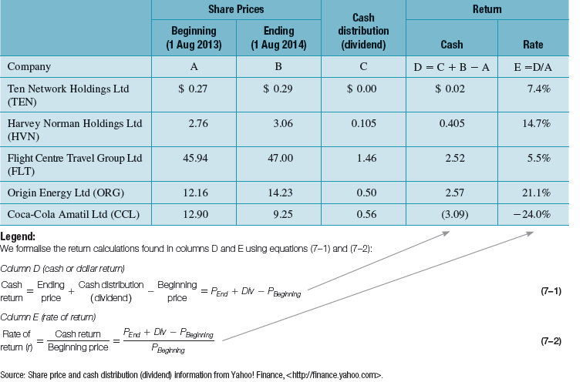
Measuring an investor’s realised rate of return from investing in ordinary shares
Source: Share price and cash distribution (dividend) information from Yahoo! Finance, <http://finance.yahoo.com>.

Slide 9
Calculating the realised return from an investment (cont.)
The Table indicates that the returns from investing in common stocks can be positive or negative.
However, past performance is not an indicator of future performance. In general, we expect to receive higher returns for assuming more risk.

Slide 10
Calculating the expected return from an investment
Expected return is what the investor expects to earn from an investment in the future.
It is the weighted average of the possible returns, where the weights are determined by the probability that it occurs.

Slide 11
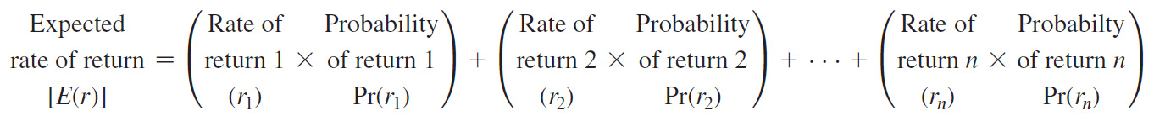
Calculating the expected return from an investment (cont.)

Slide 12
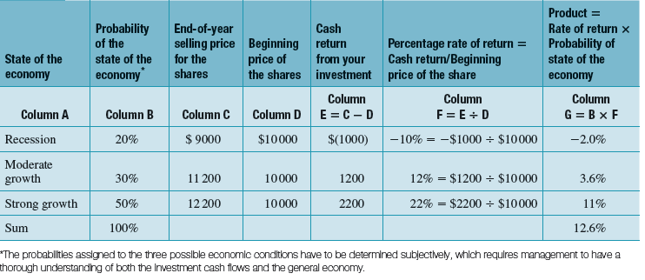
Calculating the expected rate of return for an investment in ordinary shares

Slide 13
Calculating the expected return from an investment (cont.)
Expected return
= (-10%×0.2) + (12%×0.3) + (22%×0.5)
= 12.6%
Notes:
Ask the question about only having historical return information.

Slide 14
Concept of Risk
Risk is present whenever investors are not certain about the outcome (return) an investment will produce
If the possible return values all lie close to the expected value, there is less risk than when there is a large dispersion in values, i.e., there is a probability of making substantially more or less than your expected return
Overall risk is measured as the variability of returns - we use variance or standard deviation

Slide 15
Measuring risk
In the example in the Table, the expected return is 12.6%; however, the return could range from -10% to +22%.
This variability in returns can be quantified by computing the variance or standard deviation in investment returns.

Slide 16

Measuring risk (cont.)
The variance of returns is calculated as follows:
Square the difference between each possible occurrence and the mean (squaring the differences makes all the numbers positive)
Multiply each difference by its associated probability
Sum them up:
The standard deviation is the square root of the variance and can also be used as a risk measure

Slide 17
Calculating the variance and standard deviation of the rate of return on an investment
Assume two possible investment alternatives:
  Australian Treasury bond – This Treasury bond is considered risk-free as there is no risk of default on the promised payments of 5%.
  Ordinary shares of the Ace Publishing Company – An investment in common stock will be a risky investment.

Slide 18
Calculating the variance and standard deviation of the rate of return on an investment (cont.)
The probability distribution of an investment’s return contains all possible rates of return from the investment along with the associated probabilities for each outcome.

Slide 19
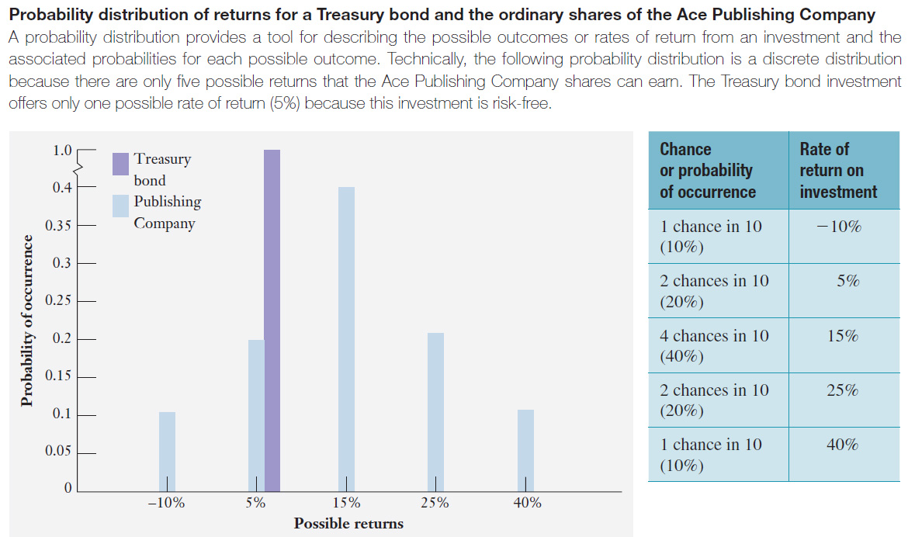
Probability distribution of returns for a Treasury Bill and the ordinary shares of the Ace Publishing Company

Slide 20
Calculating the variance and standard deviation of the rate of return on an investment (cont.)
The probability distribution for the Treasury bond is a single spike at 5% rate of return indicating that there is 100% probability that you will earn 5%.
The returns for Ace Publishing company range from a low of -10% to a high of +40%. Thus the ordinary shares investment is risky, whereas the Treasury bond is not.

Slide 21
Calculating the variance and standard deviation of the rate of return on an investment (cont.)
Expected return on the stock is 15% while the expected return on the Treasury bond is 5%.
Does the higher return of the share make it a better investment? Not necessarily, we also need to know the risk in both the investments.

Slide 22
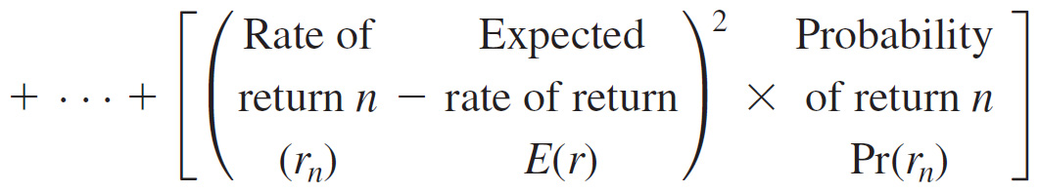
Calculating the variance and standard deviation of the rate of return on an investment (cont.)
Risk, as measured by variance:

Slide 23
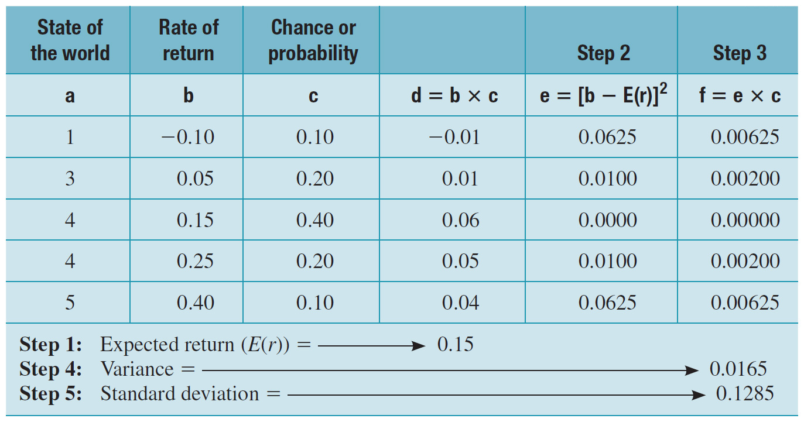
Measuring the variance and standard deviation of an investment in Ace Publishing’s Shares

Slide 24
Calculating the variance and standard deviation of the rate of return on an investment (cont.)
We observe that the shares offer a higher expected return but also entail more risk, as measured by standard deviation. An investor’s choice of a specific investment will be determined by their attitude toward risk.
Investment | Expected return | Standard deviation
Treasury bond | 5% | 0%
Ordinary shares | 15% | 12.85%

Slide 25
CHECKPOINT: CHECK YOURSELF
Evaluating an investment’s return and risk
Calculate the expected return and standard deviation for an investment with the same return but with following probabilities for the coming year: .1, .2,.4,.2 and .1.

Slide 26
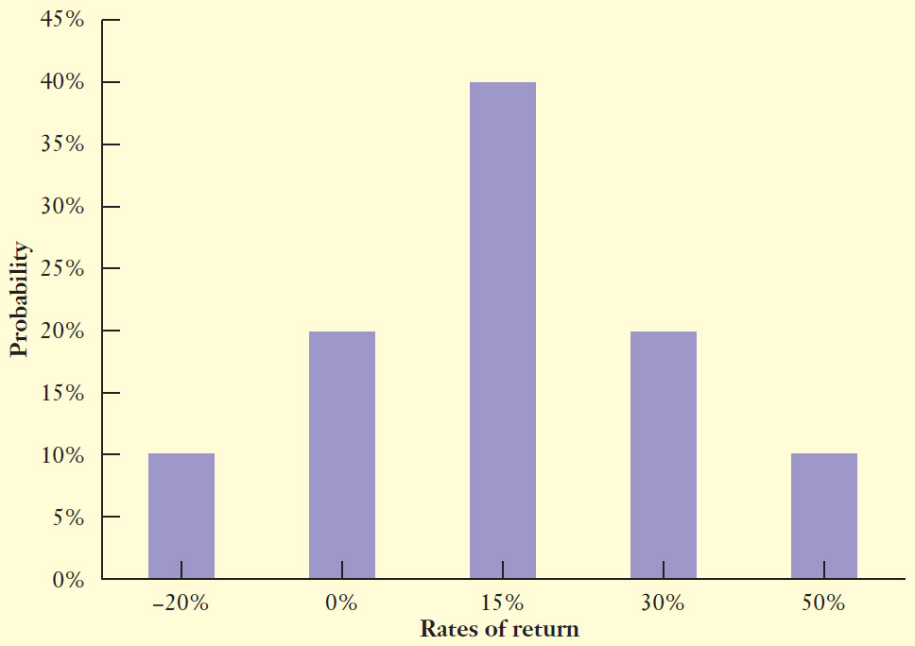
Step 1: Picture the problem

Slide 27
Step 2: Decide on a solution strategy
We can use expected return equation to measure its expected return and variance equation to measure its standard deviation.

Slide 28
Step 3: Solve
Calculating expected return
E(r) = (-20%×.10) + (0%×.2) + (15%×.4) + (30%×.2) + (50%×.1) = 15%

Slide 29
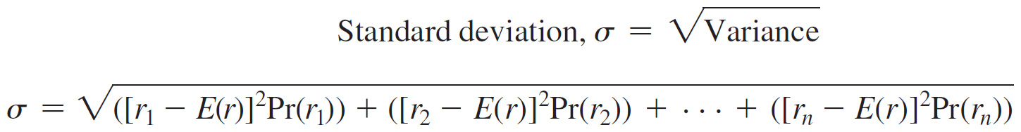
Step 3: Solve (cont.)
Calculating standard deviation
= √([-.20-.15]².1) + ([0-.15]².2) + ([.15-.15]².4) + ([.30-.15]².2) + ([.50-.15]².1)
= .183 or 18.3%

Slide 30
Step 4: Analyse
The expected return for this investment is 15%.
However, it is a risky investment as the returns can range from a low of -20% to a high of 50%. Standard deviation, a measure of the average dispersion of the investment returns, captures this risk and is equal to 18.3%.

Slide 31
Investor Preferences
All other things being equal, investors
  Like investments that increase the expected return of their investments
  Dislike investments that increase the risk of their investments
One investment dominates another if it gives:
  Higher return for the same (or lower) risk
  Lower risk for the same (or higher) return

Slide 32
Example
Stock | E(R) | Std dev
A | 0.10 | 0.01
B | 0.08 | 0.02
C | 0.09 | 0.009
Between stock A and B, which would investors prefer?
A – higher return and lower risk
Which is dominant?
A is dominant – B is dominated by A
Between stock A and C, which would investors prefer?
Cannot say directly - A has higher return AND higher risk
Which stock the investor prefers depends on the investor’s risk aversion. Less risk-averse investors will prefer A, more risk-averse investors will prefer C

Slide 33
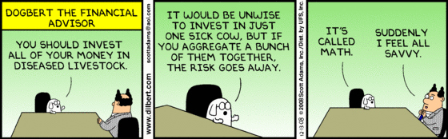
Part 2: Portfolio Returns and Portfolio Risk

Slide 34
Risk and return of portfolios
Investors usually invest in a number of assets (a portfolio)
Investors will be concerned about the return and risk of their overall portfolio
These are again calculated as average returns and variances or standard deviations
Notes:
14
14
14
14
14
14
14
14
13
13

Slide 35
Calculating the expected return of a portfolio
To calculate a portfolio’s expected rate of return, we weight each individual investment’s expected rate of return using the fraction of the portfolio that is invested in each investment.

Slide 36
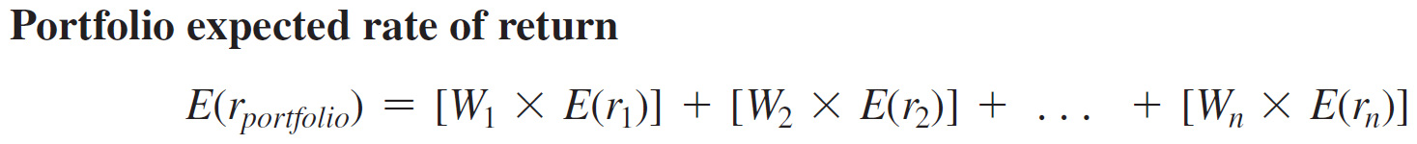
Calculating the expected return of a portfolio (cont.)
E(r_{portfolio}) = the expected rate of return on a portfolio of n assets
W_{i} = the portfolio weight for asset i
E(r_{i} ) = the expected rate of return earned by asset i
W₁ × E(r₁) = the contribution of asset 1 to the portfolio expected return

Slide 37
CHECK YOURSELF
Calculating a portfolio’s expected rate of return
Evaluate the expected return for Penny’s portfolio where she places half of her money in treasury bonds, a quarter in crown shares, and the remainder in AGL shares.

Slide 38
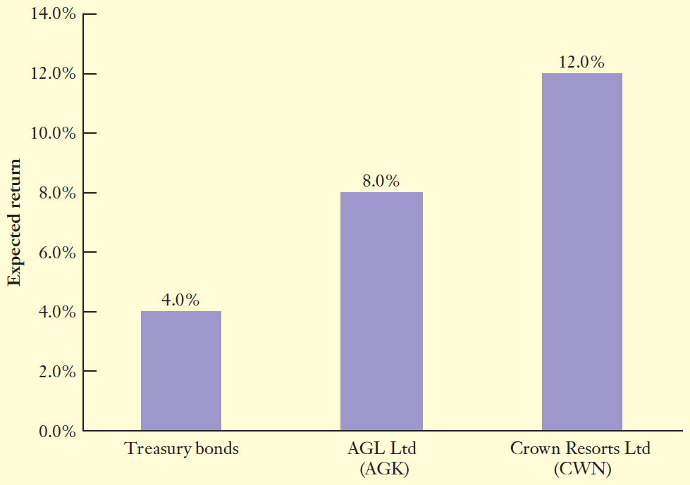
Step 1: Picture the problem

Slide 39
Step 2: Decide on a solution strategy
The portfolio expected rate of return is simply a weighted average of the expected rates of return of the investments in the portfolio.
We can use portfolio return equation to calculate the expected rate of return for Penny’s portfolio.

Slide 40
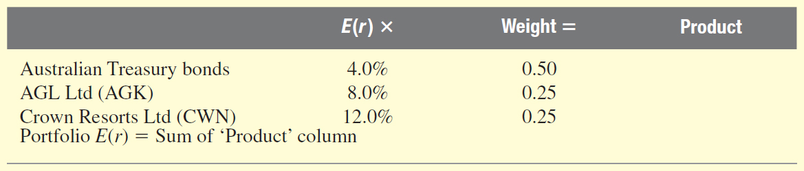
Step 2: Decide on a solution strategy (cont.)
We have to fill in the final column (Product) to calculate the weighted average.
We can also use portfolio return equation to solve the problem.

Slide 41
Step 3: Solve
Portfolio | E(r) X | Weight= | Product
Australian Treasury bonds | 4.0% | 0.50 | 2.0%
AGL Ltd (AGK) | 8.0% | 0.25 | 2.0%
Crown Resorts Ltd (CWN) | 12.0% | 0.25 | 3.0%
Portfolio E(r) |  |  | 7.0%

Slide 42
Step 4: Analyse
The expected return is 7% for a portfolio composed of 50% each in treasury bonds and 25% each in AGL and Crown shares.
Note that we have referred to the treasury bond rate as its expected rate of return. Technically, this return is assumed to be risk-free – thus, this is the only outcome.

Slide 43
Step 5: Check yourself
If we change the percentage invested in each asset, it will result in a change in the expected return for the portfolio.
Portfolio | E(r) X | Weight= | Product
Australian Treasury bonds | 4.0% | 0.25 | 1.0%
AGL Ltd (AGK) | 8.0% | 0.25 | 2.0%
Crown Resorts Ltd (CWN) | 12.0% | 0.50 | 6.0%
Portfolio E(r) |  |  | 9.0%

Slide 44
Portfolio Effect
When considering portfolio risk, it is necessary to look at both the variability of returns from each investment and the relation between returns
Stated another way, portfolio risk depends on
  The variance of each asset
  The weight in each asset
  The correlations between the returns of the assets in the portfolio
The third part leads to what is known as the “portfolio effect” or “diversification effect” where diversification of a portfolio can cause a reduction in overall risk

Slide 45
Covariance and Correlation
Covariance and its standardised measure, correlation, is a statistical measure of any relationship that may exist between two series of numbers (this could be any kind of data)
The strength of the portfolio effect is inversely related to the correlation between the returns of assets in the portfolio

Slide 46
Covariance and Correlation
Two banks
For example:
  A portfolio consisting of ANZ and NAB would exhibit a strong positive correlation and a weak portfolio effect
  A portfolio consisting of NDY and HVN may display a weak (perhaps negative) correlation and a strong portfolio effect
A mining company (NDY)
and a retailer (HVN)
Notes:
NDY = Normandy Mining
HVN = Harvey Norman

Slide 47
Covariance and Correlation
In the case of a portfolio of two securities (investments):
If the correlation coefficient between the returns is positive, then the movement of returns away from expected values would tend to be in the same direction for both securities.
  e.g., when the economy goes into a recession, returns from both asset will fall
If the correlation coefficient is negative, then returns would tend to move in opposite directions
  e.g., when the economy goes into a recession, returns from one asset will fall while the returns from the other asset will rise.
This is the principle of risk diversification

Slide 48
Evaluating portfolio risk: Portfolio diversification
The effect of reducing risks by including a large number of investments in a portfolio is called diversification.
The diversification gains achieved will depend on the degree of correlation among the investments, measured by correlation coefficient.

Slide 49
Portfolio diversification (cont.)
The correlation coefficient can range from -1.0 (perfect negative correlation), meaning that two variables move in perfectly opposite directions, to +1.0 (perfect positive correlation). The lower the correlation, the greater will be the diversification benefits.

Slide 50
Diversification lessons
A portfolio can be less risky than the average risk of its individual investments in the portfolio.
The key to reducing risk through diversification is to combine investments whose returns are not perfectly positively correlated.

Slide 51
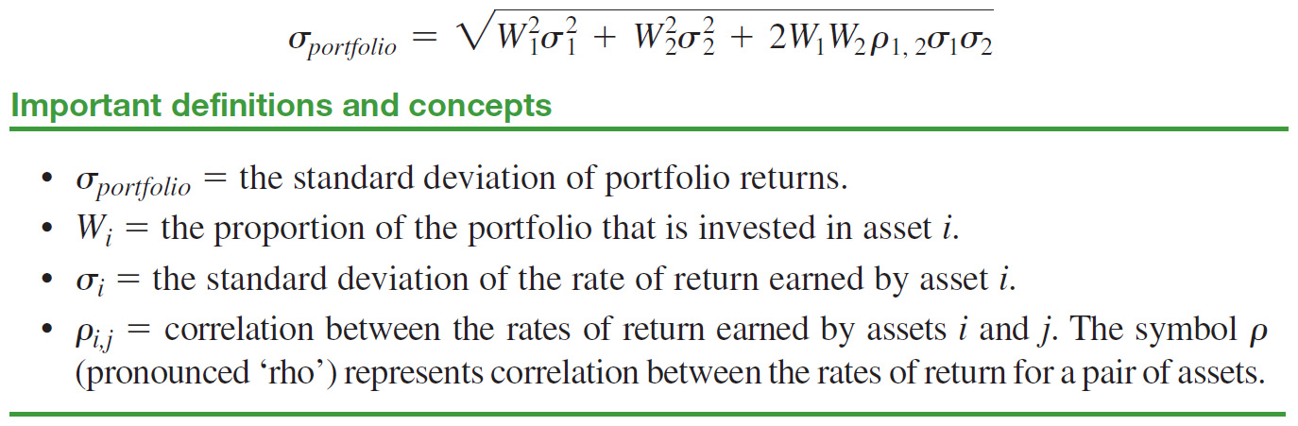
Calculating portfolio risk (2-assets)

Slide 52
CHECK YOURSELF
Evaluating a portfolio’s risk and return
Evaluate the expected return and standard deviation of the portfolio of the S&P/ASX 200 and the international fund where the correlation is assumed to be .75 and Sarah still places half of her money in each of the funds.

Slide 53
Step 1: Picture the problem
Sarah can visualise the expected return, standard deviation and weights as shown below, with the need to determine the numbers for the empty boxes.
Investment fund | Expected return | Standard deviation | Investment weight
S&P/ASX 200 fund | 13% | 20% | 50%
International fund | 15% | 30% | 50%
Portfolio |  |  | 100%

Slide 54
Step 2: Decide on a solution strategy
The portfolio expected return is a simple weighted average of the expected rates of return of the two investments given by portfolio return equation .
The standard deviation of the portfolio can be calculated using portfolio risk equation. We are given the correlation to be equal to 0.75.

Slide 55
Step 3: Solve
E(r_{portfolio})
  = W_{S&P500} E(r_{S&P500}) + W_{International} E(r_{International})
  = .5 (13) + .5(15)
  = 14%

Slide 56
Step 3: Solve (cont.)
Standard deviation of portfolio
  = √ { (.5²x.2²)+(.5²x.3²)+(2x.5x.5x.75x.2x.3)}
  = √ {.055}
  = .235 or 23.5%

Slide 57
Step 4: Analyse
A simple weighted average of the standard deviation of the two funds would have resulted in a standard deviation of 25% (20 x .5 + 30 x .5) for the portfolio.
However, the standard deviation of the portfolio is less than 25% (23.5%) because of the diversification benefits (with correlation being less than 1).

Slide 58
Step 5: Check yourself
Correlation is estimated to be 0.20
Expected return 14% (no change)
Standard deviation:
  = √ { (.5²x.2²)+(.5²x.3²)+(2x.5x.5x.2x.2x.3)}
  = √ {.055}
  = .1962 or 19.6%

Slide 59
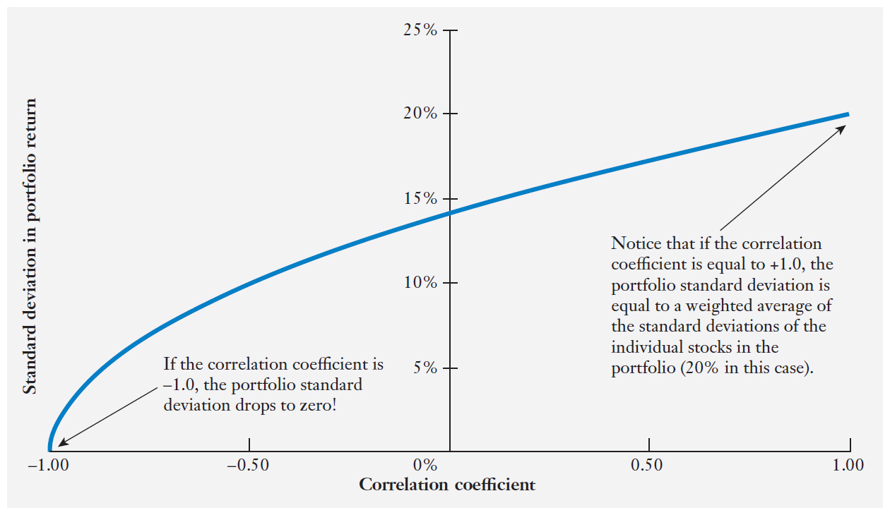
Figure 8.1 Diversification and the correlation coefficient—BHP and Coca-Cola

Slide 60
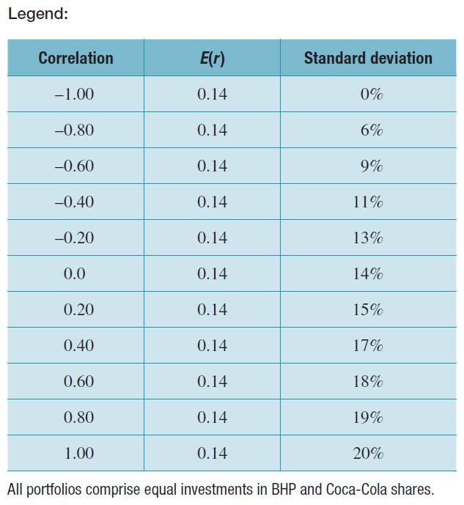
Figure 8.1 Diversification and the correlation coefficient—BHP and Coca-Cola (cont.)

Slide 61
The impact of correlation coefficient on the risk of the portfolio
We observe (from Figure 8.1) that the lower the correlation, the greater is the benefit of diversification.
Correlation between investment returns | Diversification benefits
+1 | No benefit
0.0 | Substantial benefit
-1 | Maximum benefit. Indeed, the risk of portfolio can be reduced to zero.

Slide 62
Part 3 : Capital Asset Pricing Model (CAPM)

Slide 63
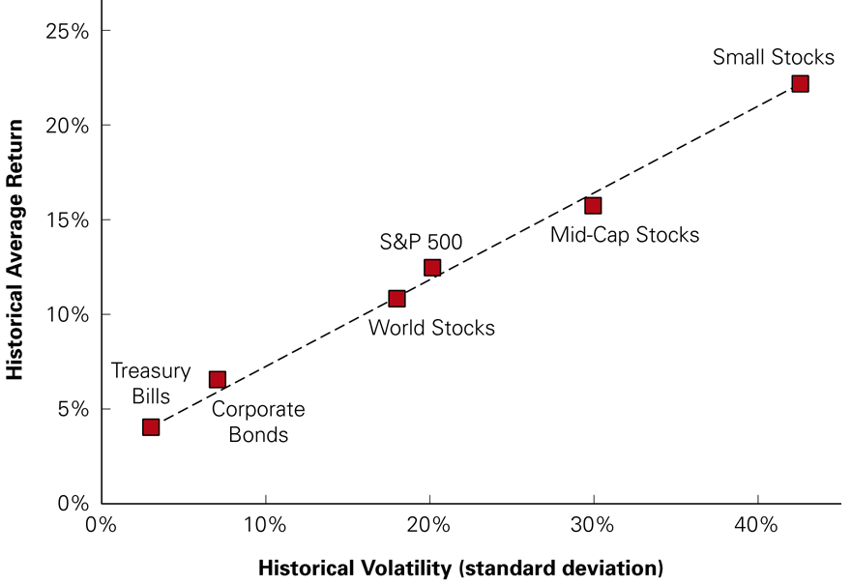
The Historical Trade-Off Between Risk and Return in Large Portfolios, 1926–2005
Source: CRSP, Morgan Stanley Capital International
Notes:
Discuss what each of these portfolios represents

Slide 64
The Returns of Individual Stocks
Is there a positive relationship between volatility and average returns for individual stocks?
  As shown on the next slide, there is no precise relationship between volatility and average return for individual stocks.
    Larger stocks tend to have lower volatility than smaller stocks.
    All stocks tend to have higher risk and lower returns than large portfolios.

Slide 65
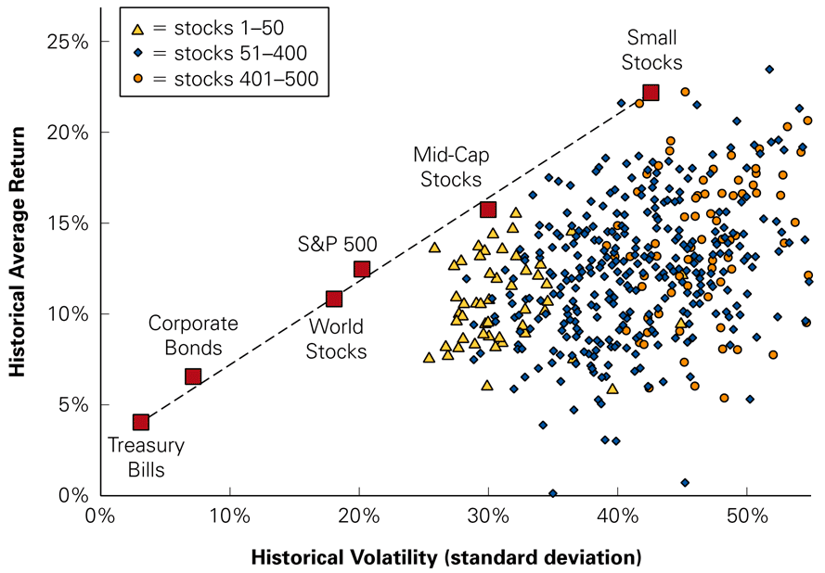
Figure 10.6 Historical Volatility and Return for 500 Individual Stocks, by Size, Updated Quarterly, 1926–2005
Notes:
If you plot return and volatility (standard deviation of returns), there is a difference between individual stocks and large portfolios.

Slide 66
Revision – 2 assets portfolio
For a portfolio with 2 assets, return on the portfolio is the weighted average of the return on each asset
Portfolio risk depends on:
  The variance of each asset
  The weight in each asset
  The correlations between the returns of the assets in the portfolio

Slide 67
N-asset portfolio return and risk
We can extend these concepts to calculate the return and risk of a portfolio of any size
The expected portfolio return for the N-asset case is still the weighted average of the expected returns of each asset (as seen with the 2 and 3-asset case)
We can write the risk in terms of covariances:
Notes:
variance is just an application of covariance
no calculation for more than 3 unequally assets porfolio

Slide 68
Diversification: The N-asset Case and Risk of an Equally Weighted Portfolio
An equally-weighted portfolio has equal amounts invested in all the assets comprising the portfolio
Average variance is therefore the arithmetic mean of the variances of returns from individual assets
Average covariance is the arithmetic mean of the covariances between pairs of assets
In the equally-weighted case, the portfolio risk can be written as:

Slide 69
Risk of an Equally Weighted Portfolio: An Example

Slide 70
The Importance of Covariance as a Portfolio Becomes Large
As N gets large, the first term approaches zero
As N gets large, the variance of each asset in a portfolio contributes little to portfolio variance
As N gets large, the second term approaches the average covariance between asset returns
As N gets large, portfolio variance is almost solely determined by covariance

Slide 71
The Importance of Covariance as a Portfolio Becomes Large
Assume we have an equally weighted portfolio of N assets, each with standard deviation of 15% and covariance of 0.01
If N=1
If N=4
Notes:
Note: simplified example - the coveriances with each other are all the same

Slide 72
The Importance of Covariance as a Portfolio Becomes Large
As we approach a well-diversified portfolio that is equally weighted, variance of the portfolio returns comes close to
Notes:
now we know the impact of the number of asset does to a portfolio
combine with correlation

Slide 73
Diversification: The N-asset Case and Limits to Diversification
General Principles
As the number of assets in the portfolio increases, the portfolio variance will decrease
In a portfolio of many assets, the risk of the portfolio depends upon the covariance between each pair of assets and not on the variances of each individual asset
  ☞ Thus, the risk reduction benefits of diversification are maximized by constructing portfolios from assets that have the lowest possible pairwise correlation
However, it does not decrease down to zero – there is some risk that cannot be diversified away

Slide 74
Common Versus Independent Risk
Common Risk
    Risk that affects all securities
Independent Risk
    Risk that affects a particular security
Diversification
    The averaging out of independent risks in a
    large portfolio
Notes:
Consider Homeowners insurance in Brisbane.
Insuring against personal liability (the risk that someone injures themselves on the insured property) will be independent between houses – that is, if your neighbor has a claim because someone tripped on a loose paving stone, you are no more or less likely to have a similar claim.
However, insuring against flood and extreme weather events will be a common risk. If your neighbor’s house is flooded, it is more likely that your house will be flooded.
If time – This is part of what happened with securitised mortgages in the financial crisis. Banks would buy up mortgages and package them to sell to investors. The credit rating companies rated these securities as investment grade (safe) partly because they treated the risk of default as an independent risk. They assumed that if one mortgage in the pool defaulted, that would have no effect on the probability of default for the rest of the mortgages in the pool. The pools, however, were not particularly diversified with respect to location, and it turned out that if your neighbor defaulted, you were actually more likely to default (perhaps because the default pushed down property values, or perhaps because you were both in the same local economy, with the same high unemployment rate). Therefore these mortgage pools were not as diversified as the credit agencies thought, and were actually much more risky than estimated.

Slide 75
Diversification in Stock Portfolios
Firm-Specific Risk
    Firm Specific events (independent risk)
    Also called idiosyncratic risk, unsystematic risk, diversifiable risk
Systematic Risk
    Market-Wide News (common risk): changes in GDP, interest rates, consumer expectations etc.
    Also called undiversifiable risk, market risk
Notes:
Firm specific events: i.e. hire new CEO, new product launch, lawsuit
Market-wide news: i.e. change in interest rates, recession, change in unemployment

Slide 76
Diversification
When many stocks are combined in a large portfolio, the firm-specific risks for each stock will average out and be diversified.
The systematic risk, however, will affect all firms and will not be diversified.
Since firm-specific risks can be diversified away, they do not increase expected return

Slide 77
Diversification
Type S firms: have only systematic risk. They move with the market and have no firm-specific risk.
  A portfolio of 10 Type S firms would have the same risk as 1 Type S firm.
Type I firms: have only firm-specific risk. What happens to the market doesn’t affect them. Type I firms are independent of each other.
  A portfolio of 10 Type I firms would have less risk than 1 type I firm as losses in some firms would offset gains in others.

Slide 78
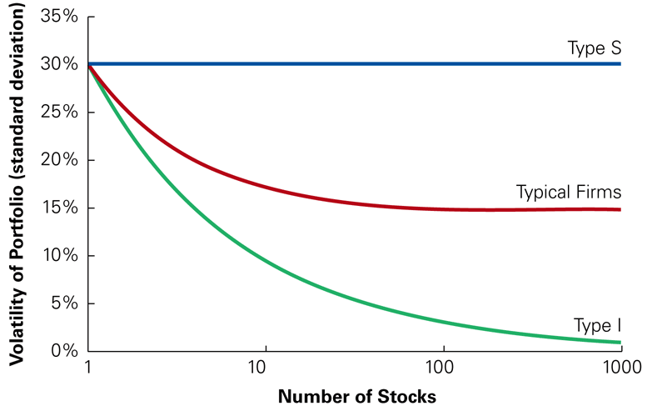
Volatility of Portfolios of Type S and I Stocks
Notes:
Typical firms are a mix – they have both systematic and firm-specific risks.

Slide 79
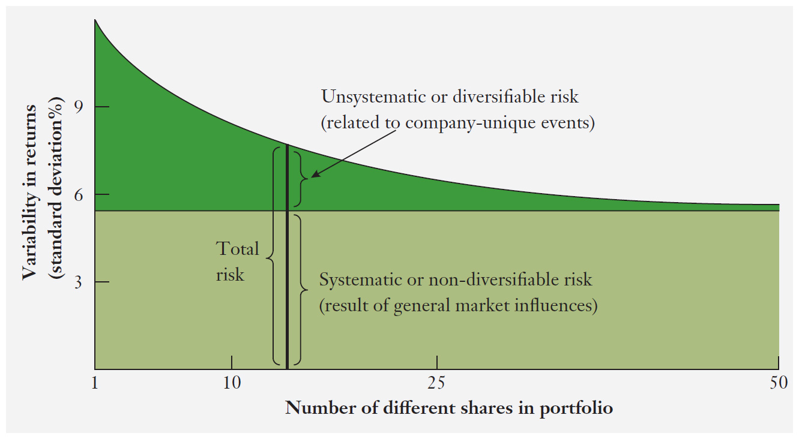
Portfolio risk and the number of investments in the portfolio

Slide 80
No Arbitrage and the Risk Premium
The risk premium for diversifiable risk is zero, so investors are not compensated for holding firm-specific risk.
  If the diversifiable risk of stocks were compensated with an additional risk premium, then investors could buy the stocks, earn the additional premium, and simultaneously diversify and eliminate the risk.
Notes:
By doing so, investors could earn an additional premium without taking on additional risk. This opportunity to earn something for nothing would quickly be exploited and eliminated. Because investors can eliminate firm-specific risk “for free” by diversifying their portfolios, they will not require or earn a reward or risk premium for holding it.

Slide 81
No Arbitrage and the Risk Premium
The risk premium of a security is determined by its systematic risk and does not depend on its diversifiable risk.
  This implies that a stock’s volatility, which is a measure of total risk (that is, systematic risk plus diversifiable risk), is not especially useful in determining the risk premium that investors will earn.
  What we need is a measure of systematic risk, not total risk.
Notes:
Standard deviation is not an appropriate measure of risk for an individual security. There should be no clear relationship between volatility and average returns for individual securities. Consequently, to estimate a security’s expected return, we need to find a measure of a security’s systematic risk.

Slide 82
Measuring Systematic Risk
To measure the systematic risk of a stock, determine how much of the variability of its return is due to systematic risk versus unsystematic risk.
  Find a portfolio that has ONLY systematic risk. We call this an efficient portfolio.
  Find out how much the stock moves, on average, for each 1% change in the return of the efficient portfolio, this is systematic risk (β).
  What’s left is unsystematic risk.
Notes:
Efficient Portfolio
A portfolio that contains only systematic risk. There is no way to reduce the volatility of the portfolio without lowering its expected return.

Slide 83
Finding an Efficient Portfolio
An efficient portfolio will be well diversified – what is the highest level of diversification we can achieve?
  If we buy a little bit of everything then we are as diversified as possible.
    How much of each? In proportion to market value.
We call this the Market Portfolio
  The S&P 500 or S&P/ASX 200 is often used as a proxy for the market portfolio.
Notes:
Discuss what a proxy is. And what is left out of this proxy: small cap firms, non equity investments.

Slide 84
Sensitivity to Systematic Risk
Measured by Beta (β)
  The expected percent change in the excess return of a security for a 1% change in the excess return of the market portfolio.
    Beta differs from volatility. Volatility measures total risk (systematic plus unsystematic risk), while beta is a measure of only systematic risk.

Slide 85
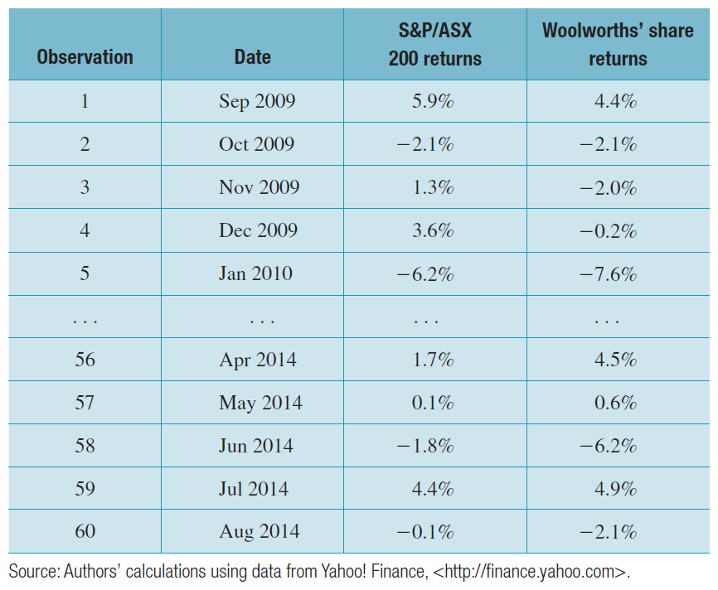
Estimating the beta coefficient for Woolworths Ltd (cont)

Slide 86
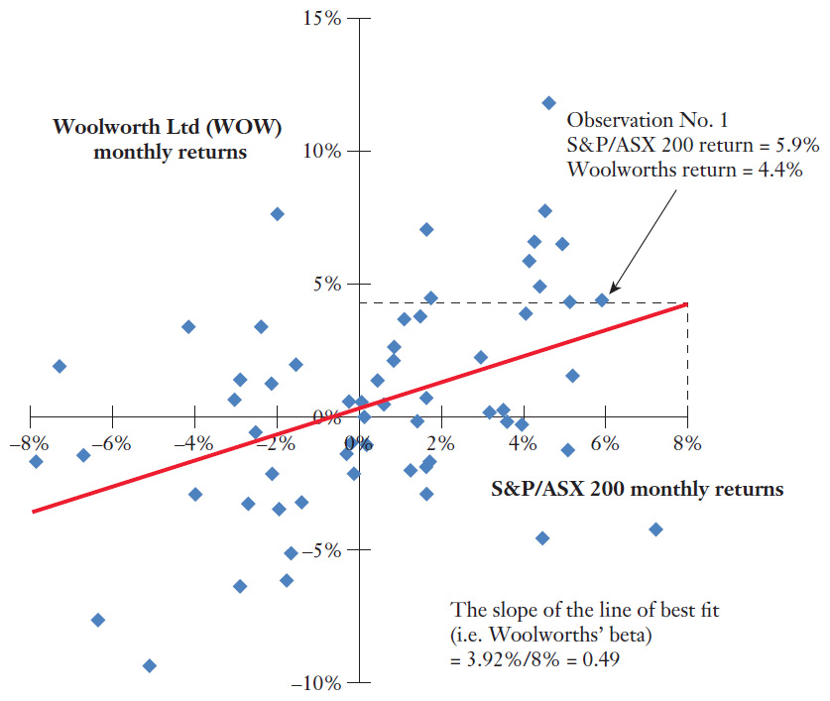
Estimating the beta coefficient for Woolworths Ltd

Slide 87
Interpreting Beta (β)
Returns will depend on underlying cash flows, which will be more sensitive to economic conditions for some firms than for others.
    Your demand for electricity will not change much as economic conditions change – so electric utilities will probably have a low beta.
    Demand for Mercedes will probably fall in a recession and rise in a strong economy – so luxury car companies will probably have high betas.
Notes:
A security’s beta is related to how sensitive its underlying revenues and cash flows are to general economic conditions. Stocks in cyclical industries are likely to be more sensitive to systematic risk and have higher betas than stocks in less sensitive industries.

Slide 88
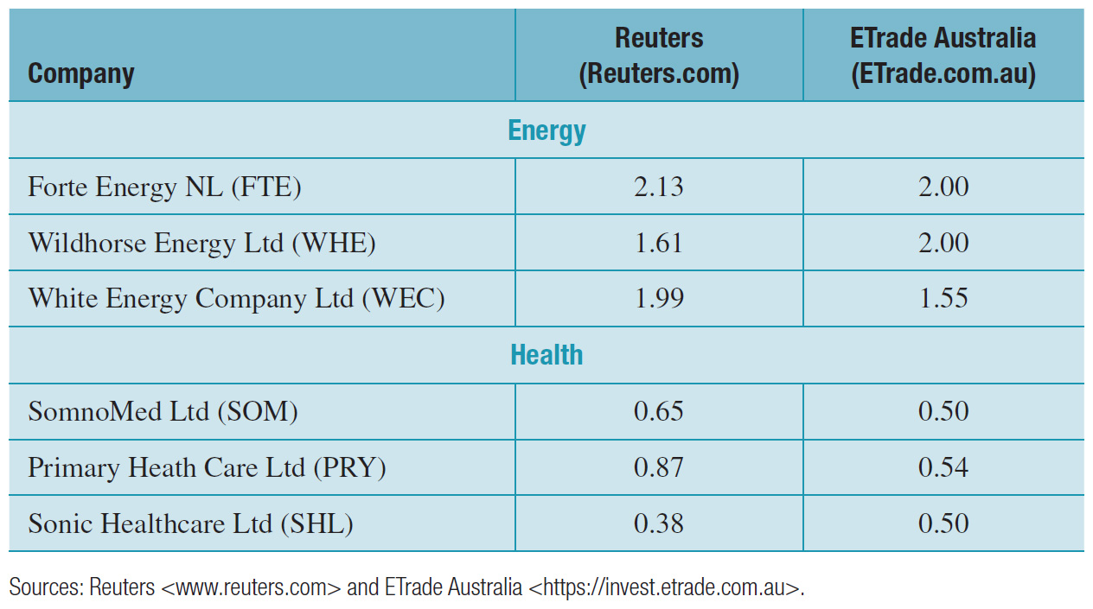
Beta coefficients for selected companies

Slide 89
Beta and the Cost of Capital
Market risk premium
    The market risk premium is the reward investors expect to earn for holding the market portfolio (or any portfolio with a beta of 1).
    It is measured as the excess of the market return over the risk free rate.

Slide 90
Beta and Cost of Capital
For securities with beta not equal to one, the risk premium demanded is proportional to beta:

Slide 91
Try it Out
Assume the economy has a 60% chance of the market return will 15% next year and a 40% chance the market return will be 5% next year.
Assume the risk-free rate is 6%.
If Microsoft’s beta is 1.18, what is its expected return next year?

Slide 92
Solution
E[R_{Mkt}] = (60% × 15%) + (40% × 5%) = 11%
E[R] = r_{f} + β ×(E[R_{Mkt}] − r_{f} )
E[R] = 6% + 1.18 × (11% − 6%)
E[R] = 6% + 5.9% = 11.9%

Slide 93
Beta and the Cost of Capital
This equation is often referred to as the Capital Asset Pricing Model (CAPM). It is the most important method for estimating the cost of capital that is used in practice.

Slide 94
Calculating portfolio beta
The portfolio beta measures the systematic risk of the portfolio.

Slide 95
Calculating portfolio beta (cont.)
Example: Consider a portfolio that is composed of three investments with betas equal to 1.20, 0.70 and 0.25.
If you invest half of the portfolio in the first investment and one-fourth is invested in each of the remaining investments, what will be the beta for the portfolio?
  = .5(1.2) + .25(0.7) + .25(.25)
  = 0.8375

Slide 96

Calculating portfolio expected return
CAPM
Assume risk-free rate is 4%, Market risk premium is 6%
$Expected Portfolio Return=4\%+0.8375×6\%=9.025\%$

